Slide 1
Golden Nugget
Casino Analysis
Jade Poole, Edward Kim, Yordy Cruz, Kaitlyn Prerost
12. 1. 2021.

Slide 2

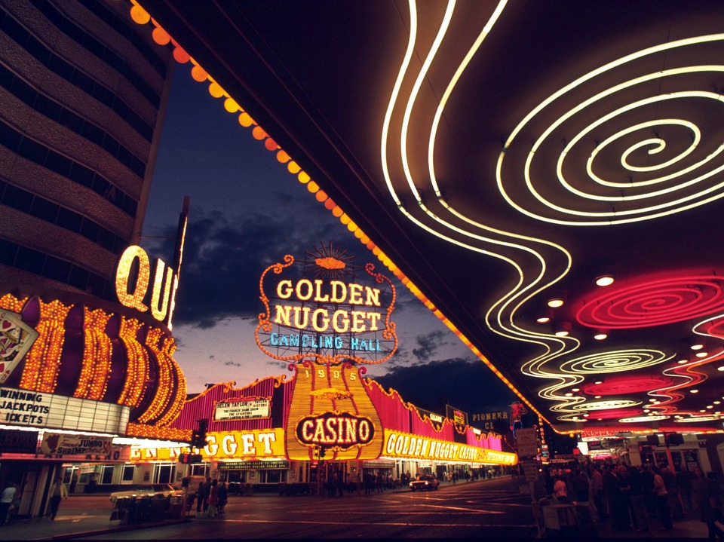

Contents
01.
Front Matter
In this section, we will be discussing the overview of the presentation as well as the agenda that we will be following.
02.
Main Body Information
In this section, we will go over the main points of the presentation. We will go over our research and the methods used to get the information.
03.
Back Matter
This last section will cover the concluding information we have for our presentation. This includes the findings from our testing and the overall conclusion.

Slide 3
Agenda
01.
02.
03.
Overview
Background
Recommendations
Here, we will discuss the overall ideas and questions associated with the usability of the Golden Nugget Hotel and Casino’s website.
In this section, we will discuss the background information involved in analyzing the Golden Nugget’s website. Background information includes: the timeline of the hotel, the success and popularity, and the statistical research we found.
This section will go over specific recommendations made to deal with certain issues pertaining to the usability of the Golden Nugget’s website.
04.
05.
06.
Methodology
Findings
Conclusion
To further our understanding of the usability of the Golden Nugget’s website, we had to conduct surveys. This section will show the methods and applications used to conduct these questionnaires.
Here, we will discuss the findings that came from conducting our surveys. This will go over the data and how the information relates to the previous observations we made on our own.
In this section, we will conclude the entire presentation. This conclusion will include: the background, the recommendations, the methodology, and the findings. We will conclude our overall thoughts on the usability of the Golden Nugget’s website.

Slide 4
OVERVIEW OF THE GOLDEN NUGGET CASINO

Slide 5
Overview 01.
What are the issues we are aiming to address concerning usability?
Unappealing Visuals
Difficult Layout
Advertisements
The color palette and font choice makes website have a dated and out of date look. In what ways can we update the site to better suit today’s standards?
The choices for the website layout and accessibility lend it to be more difficult. What can the site change to better improve usability?
The site includes numerous advertisements on the front page. Does this inclusion of advertisements lend to an unorganized look?

Slide 6
BACKGROUND INFORMATION
In this section we will learn more about the history and the events that lead up to the Golden Nugget today

Slide 7
TIMELINE OF THE GOLDEN NUGGET
Let’s see how it all started
1946
1977-1989
2005
2010
Present
Golden Nugget is Built
Renovations
Landry’s
Privatization
Today
Built in 1946, the Golden Nugget is one of the oldest hotels on Fremont Street
With their great success, the hotel expanded and built three towers
Landry’s Inc purchased the hotel and began another major renovation
The Golden Nugget, under Fertitta Entertainment, became privatized
Still known as a very popular spot on Fremont Street, company has become public

Slide 8
Goals & Objectives
Overview Goal and Objectives for improving the website
Modernize
Improve
Longevity
Our goal is to modernize the website to catch up with current trends and changes.
We hope to overall improve the website to match with the competitors.
Not to only improve, but perform in the long run and catch up to new trends.

Slide 9
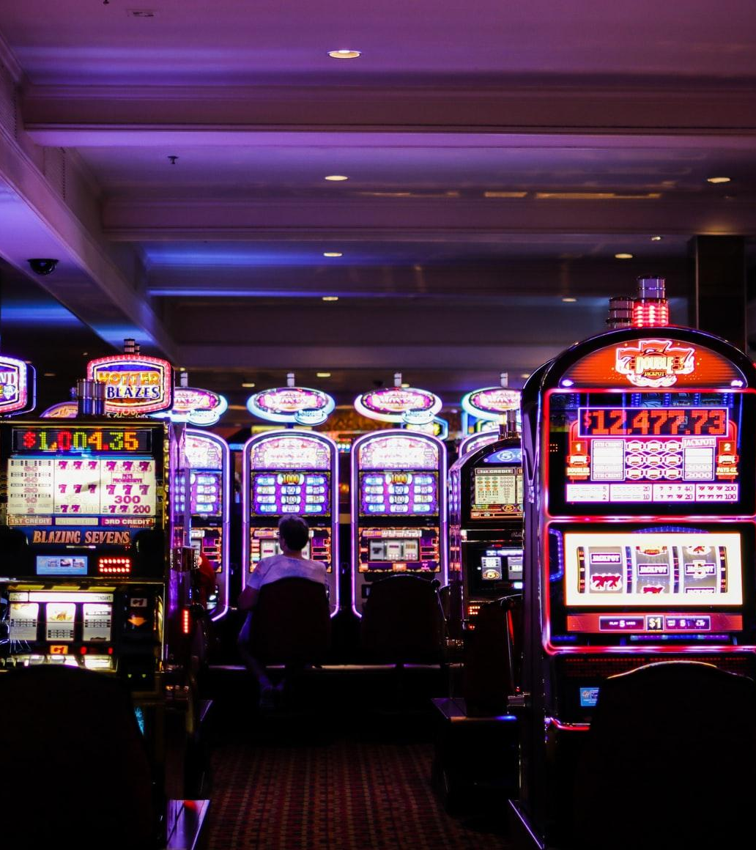


Modernization
Share Holder
Tilman Fertitta #1 shareholder at ~two billion dollars
Competitors
Aria Resort & Casino
Hilton Resorts World
Steps forward
Modernize website to catch with current time
and match with competitors

Slide 10

Research
What elements makes a website attractive to customers? How does Golden Nugget compare to its competitors?
Assessments and Measures
Survey
Google forms: 18 questions surveyed 18 people
Pie charts
Line graphs
Bar graphs
Short response
Findings
Display the results from 18 participants and conclude the Golden Nugget website usability to its competitors

Slide 11
Website Usability Survey
STEP 01.
STEP 02.
Background information on the participants,
Age
Gender
Education
Experience with Casinos.
Asked our participants to explore the website
Then answer remaining survey questions:
Examples:
Would they visit the casino website
what made the website good or bad,
Whats would change from the website,
Golden Nugget

Slide 12
Survey Findings
Demographic of our participant's
How easy it was to navigate Golden Nugget Website
Overall appearance of the Golden Nugget Website
11.1%
5.6%
11.8%
17.6%
11.8%
17.6%
5.6%
72.2%
11.8%
5.6%
52.2%
17.6%
58.8%
Under 18
18 -24
25-34
35-44
45-54
55-64
Above 64
Acceptable
Good
Excellent
Poor
Acceptable
Good
Excellent
Poor

Slide 13
Survey Results
Improvement to Golden Nugget website
Changes need to be made
Add more pictures
Changing the color scheme
Improving navigation
Website had too much clutter
Every section overwhelmed information
Too many offers/ads.
01
02
03
Compare Competitors
Lacking critical elements like the MGM gambling app
Less attractive and need modernize
Below average
Better than Tropicana website
Above average
Fast and easy to use

Slide 14
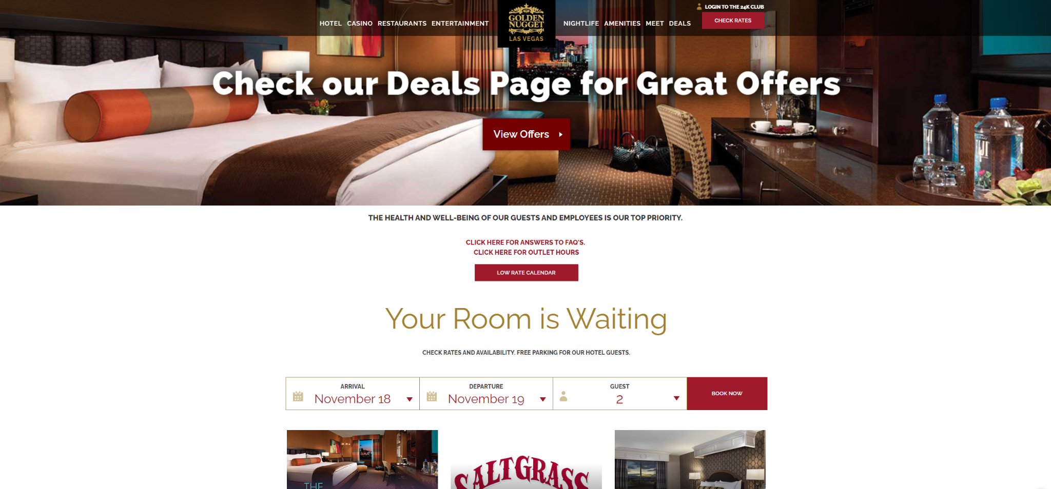
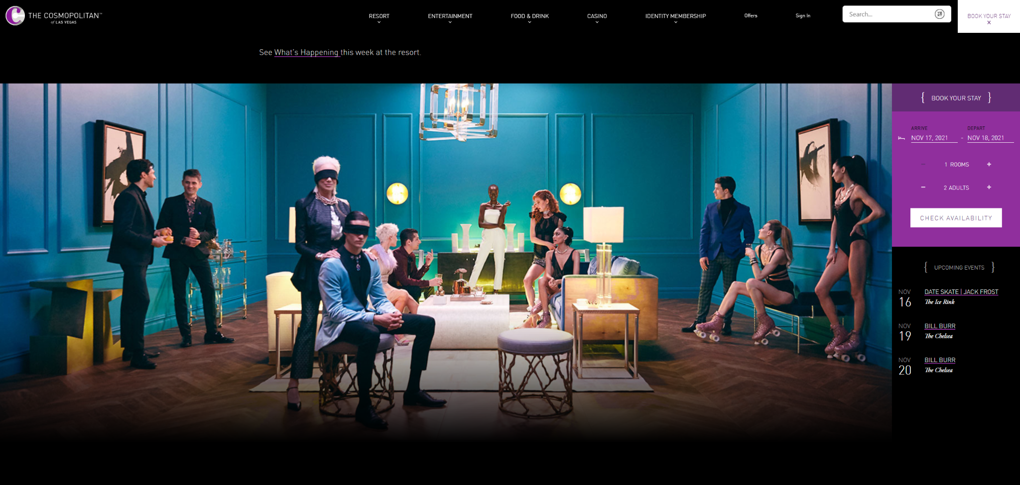
Competitors
Left: Golden Nugget Casino Right: Cosmopolitan Hotel
Layout
Theme
Suggestions
Minimalist appearance
Similar color theme throughout and emphasis on certain words
Search bar for quick search and use similar theme colors throughout

Slide 15
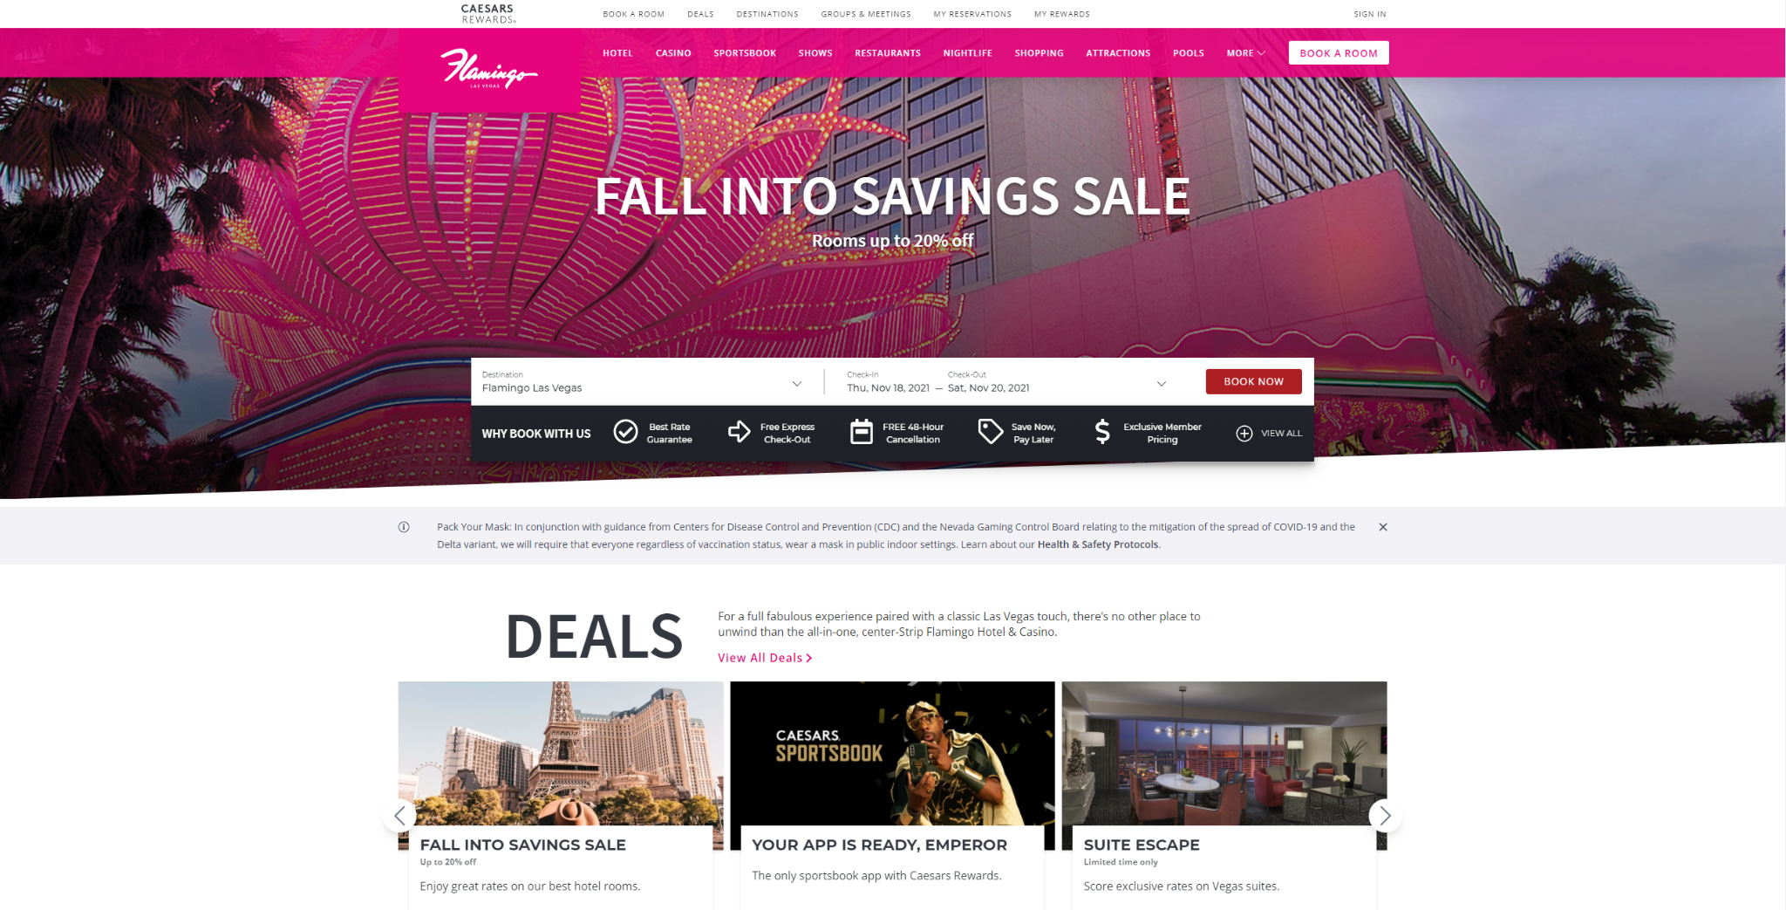
Competitors
Left: Golden Nugget Casino Right: Flamingo Hotel & Casino
Layout
Theme
Suggestions
Well Organized
Similar Layout
More Expression of
Character
Reference Flamingo due to similar layout

Slide 16
Overall Improvement
What can we do to make the website better?
Easier Navigation
Visuals
Advertisements
Change the site to have better fit users and get rid of confusing tabs
Choose an overall better color palette together with visual components
Get rid of clutter of advertisements and offers for customers

Slide 17
Thanks !
This has been our analysis of the
Golden Nugget Website

